Slide 1
Illinois workNet Orientation
Every Monday 9:00 – 10:30
(Except Holidays)
1300 South 9th St.
Springfield, IL 62703

Slide 2
Workforce Innovation and Opportunity Act (WIOA)
Education
Increase Access to Education
Workforce Investment
Increase Prosperity of Workers and Employers
Economic Development
Enhance Productivity and Competitiveness
Funding for Training
OJT
Employment Services
Labor Market
Info

Slide 3
Resource Room Services
Computer Access for Job Search/ Online Applications
Copier/FAX/Printer
Direct Linkage to all workNet partners
Weekly Workshops
Employer presentations and hiring events
Monday Orientation of Services

Slide 4
workNet Organizations and Services
Illinois Department of Employment Security (IDES)
Unemployment Compensation
Local Veterans’ Employment Representative
Employment Services
Department of Human Services (DHS)
Supplemental Nutrition Assistance Program (SNAP) Benefits
Temporary Assistance for Needy Families (TANF)
Department of Rehabilitation Services Vocational Counselors
Illinois Community College Board (ICCB)
Lawrence Education Center
Lincoln Land Community College
Capital Area Career Center
Department of Commerce and Economic Opportunity (DCEO)
Land of Lincoln Workforce Alliance/Education and On-the-Job Training (WIOA)
Trade Adjustment Programs
Other Partners
Community Action
Area Agency on Aging
National Able
Job Corps

Slide 5
Sangamon County Department of Community Resources
Striving to improve the quality of life for people with low incomes in Sangamon County through department programs, services and referrals that promote stability and/or self-determination.
*LIHEAP Utility Assistance *Life Skills/Goal Setting
*Weatherization Services *Housing Counseling
*Financial Literacy *GED Test Financial Assistance
*High School Summer School Tuition *Rent/Employment Supports
*Emergency Dental/Medications
*Educational Scholarships for Adults and High School Seniors
*Personal Care Assistant and Certified Nursing Assistant Programs
2833 S. Grand Ave. East 217-535-3120

Slide 6
The Area Agency on Aging (AAA)
The Area Agency on Aging is a state agency established within a region to provide information, resources, and referrals to community services for seniors. The services of an Area Agency on Aging may include:
Coordination of local Long-term Care Ombudsman programs.
Nutritional support through counseling or referrals to organizations that provide meal delivery.
Expertise and advice in eligibility and the application process for Medicare, Medicaid, and veteran’s benefits.
Referrals to community based resources for elder assistance such as transportation and respite care.
Elder care training and caregiver support programs.
3100 Montvale Drive 217-787-9234

Slide 7
Senior Community Service Employment Program (SCSEP)
You can JOIN US by applying online https://www.nationalable.org/about/ or by calling 855-994-8300
Must be at least 55 years of age
Meet program income requirements
Are willing to improve your job skills and learn new skills
You will:
Receive interviewing and job-search assistance
Obtain computer and vocational training
Earn while you learn at a location in your community
Gain access to employers who want to hire experienced workers
Improve your employable skills

Slide 8
Job Corps
Career Training and Education
If you are 16–24 years old and looking to make a change or advance your career, get TUITION-FREE training at Job Corps.
Job Corps offers many career paths. Some you may never have considered before, including:
Advanced Manufacturing Automotive and Machine Repair Construction Health Care Finance and Business Hospitality Information Technology Transportation
309 966 0130
(800) 733-5627
https://www.joinjobcorps.com

Slide 9
Capital Area Career Center (CACC)
Capital Area Career Center provides an educational environment that assists students in discovering their potential through the development of occupational skills, positive work ethic characteristics and leadership skills. Students have access to technology-enriched curriculum, taught by a highly competent staff, using state of the art equipment.
CNA classes are available, as well as, Adult Nursing classes through Capital Area School of Practical Nursing,
Skilled Trades Essentials Program
2201 Toronto Road 217-529-5431

Slide 10
Lawrence Education Center
High school credit courses leading to a diploma
High School Equivalency Exam prep
Career Exploration courses.
Students must turn 17 before May 1 in order to enroll in the HSE Exam prep courses.
Academic and vocational components in an open entry enrollment setting
Allowing students to enroll and begin their classes at almost any point during the school year
High School Equivalency test prep students complete lessons preparing them for the GED test, which they may take once the instructor determines they are good candidates for success.
101 E Laurel Street 217-525-3233

Slide 11
Division of Rehabilitation Services (DRS)
Bureau of Field Services
Assist individuals with disabilities prepare for, obtain, and maintain competitive employment.
Services include:
Evaluation Education
Guidance Physical and Mental Restoration
Counseling Assistive Devices
Training Job Development, Placement, and Post-Employment

Slide 12
Division of Rehabilitation
Bureau of Blind Services
Aids those who are blind or visually impaired to maintain independence
Achieve employment, education, training goals
Short term residential and independent living services
Bureau of Home Services
Wide range of services to individuals with significant disabilities to remain in their homes and live independently
Additional Services
*Client Assistance Services for Deaf or Hard Hearing *Hispanic/Latino
*Independent Living Administrative *Support Services *Educational Services
600 E Ash St, Building 400 - 217-782-4830

Slide 13
Illinois Department of Employment Security
Apply for Unemployment Benefits
www.ides.illinois.gov
800-244-5631
Registration in Illinois Job Link
www.illinoisjoblink.com
Resume Development
Interview Preparation
Job Search Assistance
Labor Market Information
Employer Incentives
This workforce product was funded by a grant awarded by the U.S. Department of Labor's Employment and Training Administration. The product was created by the grantee and does not necessarily reflect the official position of the U.S. Department of Labor. The Department of Labor makes no guarantees, warranties, or assurances of any kind, express or implied, with respect to such information, including any information on linked sites and including, but not limited to, accuracy of the information or its completeness, timeliness, usefulness, adequacy, continued availability, or ownership. This product is copyrighted by the institution that created it. Internal use by an organization and/or personal use by an individual for non-commercial purposes is permissible. All other uses require the prior authorization of the copyright owner.
The Illinois workNet Center System, an American Job Center, is an equal opportunity employer/program. Auxiliary aids and services are available upon request to individuals with disabilities. All voice telephone numbers on this website may be reached by persons using TTY/TDD equipment by calling TTY (800) 526-0844 or 711. – February 2019

Slide 14
Unemployment Insurance Benefits (UI)
Last for up to 26 weeks
(approximately 6 months in a 52 week period)
Currently no extensions
Compensation while searching for new employment
File claim after last day of work.
Certify bi-weekly to request payments.
Must have written proof of job search, employer contacts

Slide 15
Unemployment Insurance Benefits
3 “A”s
You Must be Able to work
You Must be Available to work
You Must be Actively Seeking work

Slide 16
Registration in Illinois JobLink
Actively seeking work…or benefits will be suspended.
Registered in Illinois Job Link
Active Updated Resume – UI registered
Actively search for work
Apply for positions
Record Activity
www.illinoisjoblink.com

Slide 17
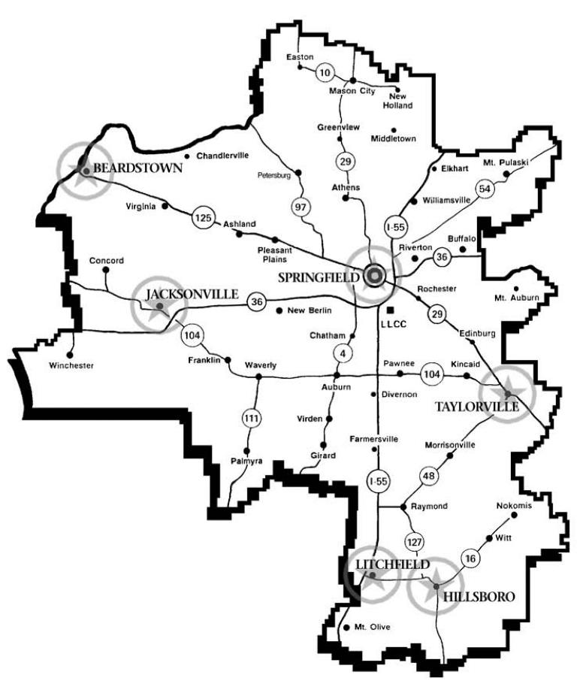
District 526
The LLCC District is composed of all or parts of 15 central Illinois counties: Bond, Cass, Christian, DeWitt, Fayette, Greene, Logan, Macon, Macoupin, Mason, Menard, Montgomery, Morgan, Sangamon and Scott. www.llcc.edu

Slide 18
FINANCIAL AID
Free Application for Federal Student Aid
FAFSA
www.fafsa.gov
LLCC School Code - 007170
if interested in receiving financial aid

Slide 19
FINANCIAL AID
LLCC Financial Aid contact information
217-786-2237
www.llcc.edu/financial-aid

Slide 20
Getting Started at LLCC
Complete the Application (free)
Attend New Student Orientation (free)
Meet with your Advisor/Success Coach (free)
Visit www.llcc.edu/getting-started for details!

Slide 21
TRUCK DRIVER TRAINING (CDL)
Transportation Center of Excellence
Certificate Program - successfully equip you for a career in the trucking industry:
Truck Driver Training CDL Basic, Certificate of Completion
Time to completion: 4 weeks (day) or 6 weeks (night)
The program has four 2004 and one 2016 Freightliner tractors with straight 10 speeds and 53′ box trailers.
For more information or to schedule an appointment, please contact Bob Howard at 217-786-2565, 217-786-4539 or bob.howard@llcc.edu
www.llcc.edu/truck-driver-training/

Slide 22
Highway Construction Careers Training –
www.llcc.edu/highway-construction-careers-training
IDOT has funded this program to expand the number of people in historically underrepresented populations who enter a highway construction career.
This is an intensive program that addresses skills necessary for acceptance into a highway construction career: math for the trades, job readiness and technical skills coursework.
Students will leave the completed highway construction careers training with the following certifications: OSHA 10, Forklift, CPR/First Aid Training, Flagger and Scissor lift.
Students will have gained the opportunity to excel when applying for a new career with high wage earning potential.
For more information or to register for an orientation, please contact Thomas Spears at 217-786-3675, 217-786-2407 or thomas.spears@llcc.edu /

Slide 23
Adult Education at LLCC
Adult Basic Education
Assist eligible adults improve their reading, writing, math and technology skills
High School Equivalency
(HSE) test, such as GED or TASC
English as a Second Language (ESL)
Serving students from approximately 40 countries who speak up to 35 languages
Adult Career Pathways
Earn college credit and a certificate in the process, along with technology and employability
www.llcc.edu/adult-education

Slide 24
Adult Education – Adult Career Pathways
Benefits
Team-teaching approach
Access to ongoing advising/counseling and support services.
Students complete a career interest survey and participate in career planning.
designed for students to earn college credits and at least one credential, certificate and/or degree.
Eligibility Requirements and Guidelines
Must be highly motivated and committed to achieving career/educational goals
Demonstrate a deficiency in reading, writing and/or math.
Apply for federal financial aid.
Attend academy week.
www.llcc.edu/adult-career-pathways/

Slide 25
Contact and visit information
Mac Warren Mac.Warren@llcc.edu
Campus Visit Days and program expos are offered throughout the year. For information on upcoming visit opportunities, please visit www.llcc.edu/visit

Slide 26
Workforce Innovation and Opportunity Act
WIOA can provide:
Federal funding that assists individuals with training and education, so they can find work in growing occupations and make self-sustaining wages.

Slide 27
We serve customers who live in the following counties.
Sangamon, Cass, Christian, Logan, and Menard
We research job growth in these counties and ask;
What businesses are hiring?
What jobs are in demand?
This determines which training programs WIOA will fund.

Slide 28
Workforce Innovation and Opportunity Act (WIOA)
On-the-Job Training Education

Slide 29
On the Job Training (OJT)
On-The-Job Training
Assists WIOA –eligible job seekers learn new skills while working for an employer.
The program is for full time permanent positions, at self-sufficient wages.
Employers are reimbursed up to 75 percent of the new hire’s wages for up to six months.
A business services team member works with the job seeker on their job search.

Slide 30
WIOA Eligibility
Are you Eligible to get WIOA funding assistance?
You must fit in one of the following categories:
Dislocated Workers
Low Income Adults
Low Income Youth

Slide 31
Dislocated Workers
Receiving unemployment benefits and coming from a low growth area or declining industry
Recently exhausted unemployment benefits and coming from a low growth area or declining industry
Laid off and received notice of termination letter
Your employer provided you information of a business closure within the next 180 days
No longer supported by spouse’s income due to a layoff, recent death, or divorce
The spouse of an active military member and you’ve recently relocated

Slide 32
500c5 -Receiving UI and Attending Training
Must be a WIOA approved training program
Does not extend UI benefits (26 weeks only)
500c5 is only a waiver for mandated job search
Must document attendance in class
Eligibility for re-training
Currently receiving or have exhausted UI
Based on dislocation from low-growth industry, workforce reduction or business closure

Slide 33
Low Income Adults 18 and older
Receiving SNAP, TANF, or SSI benefits
Family member of someone who receives or has received SNAP, TANF, or SSI in the last 6 months
Low income by calculation of “family income” for the last 6 months
Homeless
Diagnosed with disability

Slide 34
Low Income Youth 16 to 24 for Out-of-School youth 14 to 21 for In-School youth
Receiving SNAP, TANF, or SSI benefits
Family member of someone who receives or has received SNAP, TANF, or SSI in the last 6 months
Low income by calculation of “family income” for the last 6 months and dealing with any of the following barriers …………
A dropout with no recent school enrollment
A parent or pregnant
In a free school lunch program or living in a high poverty zone
Diagnosed with a disability
A foster child or an “aged out” foster child
Homeless or a runaway
In the Juvenile Justice System
An English language learner or basic skills deficient

Slide 35
So, if approved for WIOA………..
What can it fund?

Slide 36
WIOA can pay up to $8000.00 a year for tuition for a maximum of two years.
In addition to tuition assistance, WIOA can pay for things like:
Books
Tools
Uniforms / Work Boots
Mileage (if traveling over 30 miles round trip to class)
Daycare costs (must first ask for assistance through Community Connection Point)

Slide 37
Next Steps
1.
Meet with the school
Acceptance Letter
Financial Aid Letter
Can’t be default on previous federal
student loan
Class Schedule
start date
2.
Apply / register on websites
www.worknet20.org
www.illinoisjoblink.com
Must include a resume with current
skills, not the job skills you are planning to get
www.illinoisworknet.com
Please verify your e-mail to fully register an
account
3.
Come back any Wednesday 8:30 am
Have checklist documents copied and give to Career Planner
Schedule TABE Test with your assigned Career Planner in advance
The TABE has 3 parts
Locator, Math, & Reading
Test days and times
Wednesdays 9:00am (Must be scheduled) Mondays 1:00pm (Must be scheduled)

Slide 38
Questions?

