Slide 1
Illinois workNet Partner Orientation
1300 South 9th St.
Springfield, IL 62703
Land of Lincoln Workforce Alliance is an equal opportunity employer/program. Auxiliary aids and services are available upon request to individuals with disabilities. No individual shall be excluded from participation in, denied the benefit of, subjected to discrimination under, or denied employment in the administration of or in connection with any such program because of race, religion, sex (including pregnancy, gender identity, and sexual orientation) parental status, national origin, age, disability or political affiliation or belief or military service.
Notes:
Welcome to the Illinois workNet WIOA Partner Orientation. WIOA stands for Workforce Innovation and Opportunity Act. WIOA partners all work together under the WIOA umbrella to provide various services to help customers achieve the same common goal which is Employment. Today you will receive a general overview of the partners/services and hear from a few of the WIOA Core Partners.

Slide 2
Workforce Innovation and Opportunity Act (WIOA)
Education
Increase Access to Education
Workforce Investment
Increase Prosperity of Workers and Employers
Economic Development
Enhance Productivity and Competitiveness
Funding for Training
OJT
Employment Services
Labor Market
Info

Slide 3
Career /Resource Room Services
Computer Access for Job Search/ Online Applications
Copier/FAX/Printer
Direct Linkage to all workNet partners
Scheduled Workshops
Employer presentations and hiring events
Partner Orientation of Services
Notes:
Here at the workNet Center we have over 40 computers available to the public to work on your resume, conduct your job search, research labor market information and training programs, and to complete online job applications. We provide a direct linkage phone to all partners not physically here at the Center. We also periodically schedule various work shops and employer hiring events.

Slide 4
workNet Partner Organizations and Services
Capitol Area Career Center (Perkins Services)
Illinois Department of Employment Security (IDES)
Illinois Department of Human Services (DHS)
Illinois Department of Rehabilitation Services (DRS)
Land of Lincoln Workforce Alliance (WIOA Services)
Lawrence Education Center (Adult Education Services)
Lincoln Land Community College (Perkins and Adult Education Services)
National Able, Caritas and NAPCA (Aging Workforce Services)
Sangamon County Community Resources (LIHEAP, Weatherization, CSBG Services)
Notes:
The workNet Center serves as a One Stop for an array of services individuals may need. Here is a quick overview of all of our partners. A few of which you will also hear from today such as IDES, LLCC, and Lawrence Education Center.

Slide 5
Capital Area Career Center (CACC)
Capital Area Career Center provides an educational environment that assists students in discovering their potential through the development of occupational skills, positive work ethic characteristics and leadership skills. Students have access to technology-enriched curriculum, taught by a highly competent staff, using state of the art equipment.
Adult CNA classes are available as well as, Practical Nurse Training (LPN) through the Capital Area School of Practical Nursing
STEP Youth Program-Pre-Apprenticeship for Skilled Trades Essentials Program
2201 Toronto Road 217-529-5431
Notes:
CACC serves students from 22 high schools in Springfield and in surrounding communities. They also house an Adult C NA training program and the LPN training program through the Capital Area School of Practical Nursing. In addition, the Land of Lincoln Workforce Alliance oversees and provides funding for the STEP youth program . STEP is a pre-apprenticeship program that exposes youth participants to the Trades and also provides a paid on-the-job training component.

Slide 6
Illinois Department of Employment Security
Apply for Unemployment Benefits
www.ides.illinois.gov
800-244-5631
Schedule an Appointment at 217-558-0401
Complex questions call 800-244-5631 to schedule a callback
Registration in Illinois Job Link
www.illinoisjoblink.com
Resume Development
Interview Preparation
Job Search Assistance
Labor Market Information
Employer Incentives
This workforce product was funded by a grant awarded by the U.S. Department of Labor's Employment and Training Administration. The product was created by the grantee and does not necessarily reflect the official position of the U.S. Department of Labor. The Department of Labor makes no guarantees, warranties, or assurances of any kind, express or implied, with respect to such information, including any information on linked sites and including, but not limited to, accuracy of the information or its completeness, timeliness, usefulness, adequacy, continued availability, or ownership. This product is copyrighted by the institution that created it. Internal use by an organization and/or personal use by an individual for non-commercial purposes is permissible. All other uses require the prior authorization of the copyright owner.
The Illinois workNet Center System, an American Job Center, is an equal opportunity employer/program. Auxiliary aids and services are available upon request to individuals with disabilities. All voice telephone numbers on this website may be reached by persons using TTY/TDD equipment by calling TTY (800) 526-0844 or 711. – February 2019
Notes:
On the IDES website you can apply and certify for benefits. Sign up for Direct Deposit, change a password, or start your job search. If you need to schedule an appointment for in-person services you need to call 217-558-0401. Limited in-person services are available for identity verification and employment services.

Slide 7
Unemployment Insurance Benefits (UI)
Last for up to 26 weeks
(approximately 6 months in a 52 week period)
Currently no extensions
Compensation while searching for new employment
File claim after last day of work.
Certify bi-weekly to request payments.
Must have written proof of job search, employer contacts

Slide 8
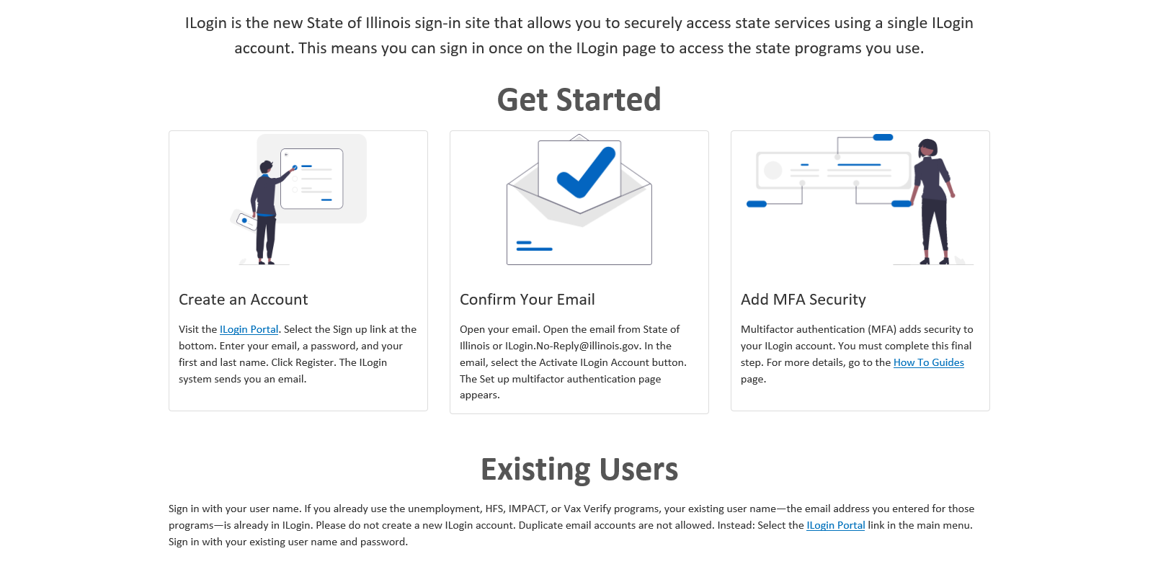
ILogin
Notes:
ILogin is a new, required security feature and step to protect users and IDES from fraudulent activity. Explain above steps.

Slide 9
Unemployment Insurance Benefits
3 “A”s
You Must be Able to work
You Must be Available to work
You Must be Actively Seeking work
Notes:
Also Explain how training may impact benefits. Need for 500C5 form, etc.

Slide 10
Registration in Illinois JobLink
Actively seeking work…or benefits will be suspended.
Registered in Illinois Job Link
Active Updated Resume – UI registered
Actively search for work
Apply for positions
Record Activity
www.illinoisjoblink.com
Notes:
Registration in IJL is required in order to receive benefits. Also Mention/Explain how training may impact benefits. Need for 500C5 form, etc.

Slide 11
Division of Rehabilitation Services (DRS)
Bureau of Field Services
Assist individuals with disabilities prepare for, obtain, and maintain competitive employment.
Services include:
Evaluation Education
Guidance Physical and Mental Restoration
Counseling Assistive Devices
Training Job Development, Placement, and Post-Employment
Notes:
DHS's Division of Rehabilitation Services is the state's lead agency serving individuals with disabilities. DRS works in partnership with people with disabilities and their families to assist them in making informed choices to achieve full community participation through employment, education, and independent living opportunities.

Slide 12
Division of Rehabilitation
Bureau of Blind Services
Aids those who are blind or visually impaired to maintain independence
Achieve employment, education, training goals
Short term residential and independent living services
Bureau of Home Services
Wide range of services to individuals with significant disabilities to remain in their homes and live independently
Additional Services
*Client Assistance Services for Deaf or Hard Hearing *Hispanic/Latino
*Independent Living Administrative *Support Services *Educational Services
600 E Ash St, Building 400 - 217-782-4830
Notes:
DRS staff provide services to people with disabilities in 47 local offices located in communities throughout the state. They also have funding available for those who qualify for education and training. They have an online Web Referral available on their website where you may refer yourself or staff here at the Center can also provide a referral for you. https://wr.dhs.illinois.gov/wrpublic/wr/dynamic/referral.jsf

Slide 13
Workforce Innovation and Opportunity Act
WIOA Title I can provide:
Federal funding that assists individuals with training and education, so they can find work in growing occupations and earn self-sustaining wages.
Notes:
The Land of Lincoln Workforce Alliance administers WIOA Title I funding for education and training. The Workforce Investment Act of 1998 (WIOA) established a “customer choice” approach to services through a system of Individual Training Accounts (ITAs). WIOA funding is available to eligible and suitable customers who require additional skills in order to obtain self-sufficient employment.

Slide 14
The LLWA serves customers who reside in the following counties.
Sangamon, Cass, Christian, Logan, and Menard
We research job growth in these counties and ask;
What businesses are hiring?
What jobs are in demand?
WIOA approved training providers and programs can be found at https://www.illinoisworknet.com/wioatrainingsearch
Notes:
ETPL – Eligible Training Provider List-- Under WIOA local workforce areas are required to fund only areas of study that have a high probability of resulting in employment of a self-sufficient wage. Local WIOA staff review training providers and programs on a regular basis to ensure only those programs which have been determined to lead to long-term self-sufficient employment are available for funding. Programs must also result in occupations that are on the Statewide Approved Demand Occupation Training List.

Slide 15
Workforce Innovation and Opportunity Act (WIOA)
On-the-Job Training Education
Land of Lincoln Workforce Alliance is an equal opportunity employer/program. Auxiliary aids and services are available upon request to individuals with disabilities.

Slide 16
WIOA Eligibility
Are you Eligible to get WIOA funding assistance?
You must fit in one of the following categories:
Dislocated Workers
DWG (QUEST) Grant eligible customers
Low Income Adults
Low Income Youth
Notes:
A dislocated worker is an individual who has been laid off from their job, receiving unemployment benefits, or may have exhausted their unemployment benefits and are either still unemployed or maybe employed part-time, but not yet earning more than 80% of their dislocated wages. Low Income Adults must meet federal income guidelines or perhaps receiving public assistance such as TANF or SNAP. Low Income Youth must be a member of a low income family. There are also a few other automatic income qualifiers for youth such as homeless youth , foster children, high school drop outs, etc. There are multiple eligibility scenarios and everyone is unique. We will go through some of the specifics of each a little more in depth, but generally like to encourage everyone to just go ahead and apply, and one of our experienced Career Planners will help guide you along the eligibility process.

Slide 17
On the Job Training (OJT)
On-The-Job Training
Assists WIOA eligible job seekers to learn new skills while working for an employer while being paid.
The program is for full-time, permanent positions, at self-sufficient wages.
Employers are reimbursed up to 75 percent of the new hire’s wages for up to six months.
A business services team member works with the job seeker on their job search.
Notes:
The OJT program is a “hire-first” program in which the employer enters into an agreement with the LLWA here at the workNet Center to hire, train, and retain an individual.
Also see OJT flyer.

Slide 18
Dislocated Workers
Receiving unemployment benefits and coming from a low growth area or declining industry
Recently exhausted unemployment benefits and coming from a low growth area or declining industry
Laid off and received notice of termination letter
Your employer provided you information of a business closure within the next 180 days
No longer supported by spouse’s income due to a layoff, recent death, or divorce
The spouse of an active military member and you’ve recently relocated

Slide 19
Dislocated Workers 500c5 -Receiving UI and Attending Training
Must be a WIOA approved training program
Does not extend UI benefits (26 weeks only)
500c5 is only a waiver for mandated job search
Must document attendance in class
Eligibility for re-training
Currently receiving or have exhausted UI
Based on dislocation from low-growth industry, workforce reduction or business closure

Slide 20
DWG (QUEST) Grant eligible Quality Jobs, Equity, Strategy, Training
Has no Work History
In last 24 months, held or is currently holding a temporary, seasonal, or day-to-day job
In last 24 months, employment ended more than once
Unemployed for at least 6 of past 13 weeks with a barrier
Underemployed, works or needs to work multiple jobs, or earning less than $15/hour
Individual who does not meet traditional 1D criteria, who was laid off, fired, or voluntarily left their job due to COVID
Self-employed and now significantly underemployed due to COVID

Slide 21
Low Income Adults 18 and older
Receiving SNAP, TANF, or SSI benefits
Family member of someone who receives or has received SNAP, TANF, or SSI in the last 6 months
Low income by calculation of “family income” for the last 6 months
Homeless
Diagnosed with disability
Notes:
Priority of Service is also given – Veterans, Qualified Spouse, Low-Income, BSD. Again, our experienced Career Planners will guide you through the application and eligibility.

Slide 22
Low Income Youth 16 to 24 for Out-of-School youth 14 to 21 for In-School youth
Receiving SNAP, TANF, or SSI benefits
Family member of someone who receives or has received SNAP, TANF, or SSI in the last 6 months
Low income by calculation of “family income” for the last 6 months and dealing with any of the following barriers …………
A dropout with no recent school enrollment
A parent or pregnant
In a free school lunch program or living in a high poverty zone
Diagnosed with a disability
A foster child or an “aged out” foster child
Homeless or a runaway
In the Juvenile Justice System
An English language learner or basic skills deficient
Notes:
Under WIOA member of a family=spouse, parent, sibling, etc. Does not include boyfriend, girlfriend, or someone excluded as a family member on DHS case documentation.

Slide 23
So, if approved for WIOA………..
What can it fund?
Notes:
Programs on the Statewide ETPL may be funded.

Slide 24
WIOA Title I can pay up to $8000.00 a year for tuition for a maximum of two years.
In addition to tuition assistance, WIOA can pay for additional items such as:
Required Fees/Required Books/Certification Exams
Required Tools
Required Uniforms / Supplies
Mileage (if traveling over 5 miles round trip to class)
Daycare costs (must first ask for assistance through Community Child Care Connection https://www.4childcare.org
Notes:
WIOA is not an entitlement program. Program Suitability is also considered. Of course we want everyone to successfully complete their training programs. However, the ultimate goal is for participants to not only complete training programs and certification, but to be able to and become employed in a training-related occupation.

Slide 25
Next Steps
1.
Apply / register on websites
www.worknet20.org
www.illinoisjoblink.com
Must include a resume with current
skills, not the job skills you are planning to get
www.illinoisworknet.com
Please verify your e-mail to fully register an
account
2.
Meet with the school
Acceptance Letter
Financial Aid Letter
Can’t be default on previous federal
student loan
Class Schedule
start date
3.
Take TABE test
Have eligibility documents copied and give to Career Planner
The TABE assessment has 3 parts. The Locator, Reading, and Math
Notes:
Explain TABE- Test of Adult Basic Education. Exceptions to TABE such as associates degree or higher, individuals who have taken entrance/placement tests with passing scores within the past year. Adults & Dislocated Workers who are only entering OJT or Work Experience

Slide 26
.
Helpful to think of the process in 5 steps…….
Step 1 Build a complete file by providing all required documents.
Step 2 File is reviewed to see if eligible to receive WIOA funding. If eligible, then…
Step 3 File is put on our waiting list and monitored by supervisor for an appropriate time to move the file forward.
Step 4 File is taken off the waiting list and a career schedules an Intake interview appointment.
Step 5 Career planner goes to Committee to ask for approval of funds for your future start date, next semester, or next mod
----------------------

Slide 27
Lawrence Education Center
High school credit courses leading to a diploma
High School Equivalency Exam prep
Career Exploration courses.
PYTW- Prepare Youth to Work Program
Students must turn 17 before May 1 in order to enroll in the HSE Exam prep courses.
Academic and vocational components in an open entry enrollment setting
Allowing students to enroll and begin their classes at almost any point during the school year
High School Equivalency test prep students complete lessons preparing them for the GED test, which they may take once the instructor determines they are good candidates for success.
101 E Laurel Street 217-525-3233
Notes:
Lawrence Education Center provides Adult Basic Education, Adult Secondary Education, High School Equivalency preparation, Adult High School Diploma, Vocational Skills education and training, along with career exploration and transitional activities for students age 16 and older. Students have opportunities to explore careers and career pathways, learn employability and job survival skills, develop leadership skills, learn financial literacy skills, and earn skills leading to a certificate or credential. The Land of Lincoln Workforce Alliance oversees and funds the Prepare Youth To Work Program.

Slide 28
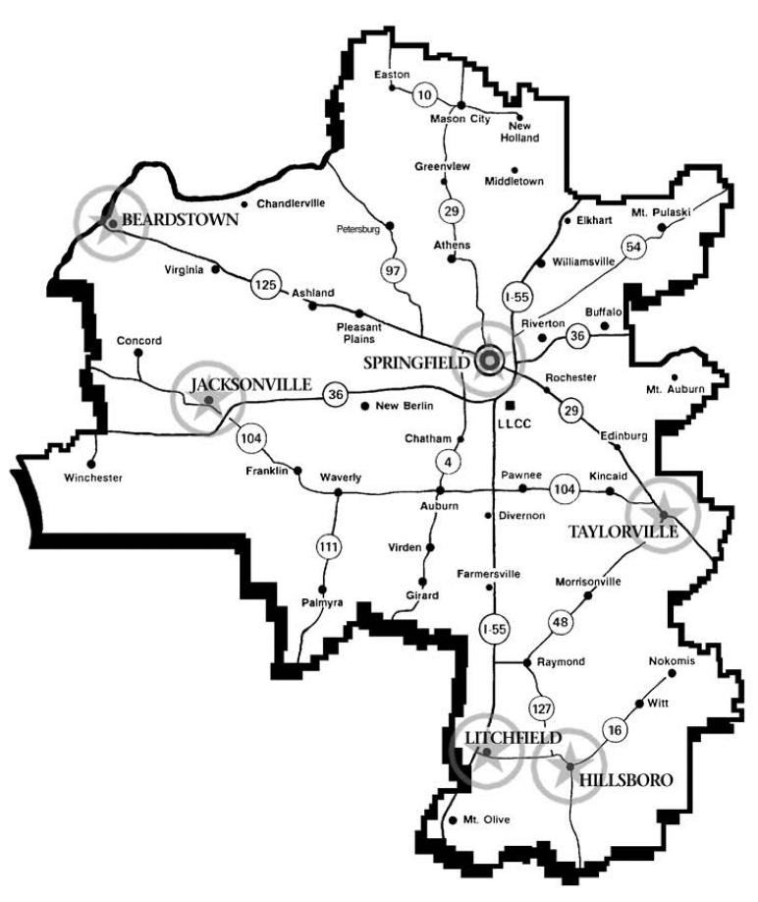
District 526
The LLCC District is composed of all or parts of 15 central Illinois counties: Bond, Cass, Christian, DeWitt, Fayette, Greene, Logan, Macon, Macoupin, Mason, Menard, Montgomery, Morgan, Sangamon and Scott. www.llcc.edu

Slide 29
FINANCIAL AID
Free Application for Federal Student Aid
FAFSA
www.fafsa.gov
LLCC School Code - 007170
if interested in receiving financial aid

Slide 30
FINANCIAL AID
217-786-2237
www.llcc.edu/financial-aid
Meet with a LLCC Financial Aid Advisor online or in person to get help filling out the FAFSA!
Notes:
Qualify for MAP, PELL, Student Loans

Slide 31
Getting Started at LLCC
Complete the Application (free) – www.llcc.edu
Attend New Student Orientation (free) – In person or online!
Meet with your Advisor/Success Coach (free) In person, online or walk in hours
Visit www.llcc.edu/getting-started for details!

Slide 32
TRUCK DRIVER TRAINING (CDL)
Transportation Center of Excellence
Certificate Program - successfully equip you for a career in the trucking industry:
Truck Driver Training CDL Basic, Certificate of Completion
Time to completion: 4 weeks (day) or 6 weeks (night)
The program has four 2004 and one 2016 Freightliner tractors with straight 10 speeds and 53′ box trailers.
For more information or to schedule an appointment, please contact Curt Robinson at 217-786-2565, 217-786-4539 or Curt.Robinson@llcc.edu
www.llcc.edu/truck-driver-training/

Slide 33
Highway Construction Careers Training –
www.llcc.edu/highway-construction-careers-training
IDOT has funded this program to expand the number of people in historically underrepresented populations who enter a highway construction career.
This is an intensive program that addresses skills necessary for acceptance into a highway construction career: math for the trades, job readiness and technical skills coursework.
Students will leave the completed highway construction careers training with the following certifications: OSHA 10, Forklift, CPR/First Aid Training, Flagger and Scissor lift.
Students will have gained the opportunity to excel when applying for a new career with high wage earning potential.
For more information or to register for an orientation, please contact Thomas Spears at 217-786-3675, 217-786-2407 or thomas.spears@llcc.edu

Slide 34
Adult Education at Lincoln Land Community College provides adults with a variety of educational opportunities in the areas of...
High school Equivalency Preparation
Adult Basic Education
English as a Second Language (ESL)
Adult career pathways and literacy.
Literacy Tutoring
Adult Education programming is free, and courses are offered year-round throughout the LLCC district, Springfield, Beardstown, Taylorville, Petersburg, Litchfield and Hillsboro. Online classes are also available.
https://www.llcc.edu/adult-education-literacy
Notes:
Contact 217-786-2349

Slide 35
Contact and visit information
Mac Warren Mac.Warren@llcc.edu
Campus Visit Days and program expos are offered throughout the year.
For information on upcoming visit opportunities, https://www.llcc.edu/visit-llcc

Slide 36
Senior Community Service Employment Program (SCSEP)
You can JOIN US by applying online https://www.nationalable.org/about/ or by calling 855-994-8300
Must be at least 55 years of age
Meet program income requirements
Are willing to improve your job skills and learn new skills
You will:
Receive interviewing and job-search assistance
Obtain computer and vocational training
Earn while you learn at a location in your community
Gain access to employers who want to hire experienced workers
Improve your employable skills
Notes:
The Senior Community Service Employment Program (SCSEP) is a community service and work-based job training program for older Americans. Authorized by the Older Americans Act, the program provides training for low-income, unemployed seniors. Participants also have access to employment assistance through your local American Job Centers.

Slide 37
Sangamon County Department of Community Resources
Striving to improve the quality of life for people with low incomes in Sangamon County through department programs, services and referrals that promote stability and/or self-determination.
*LIHEAP Utility Assistance *Life Skills/Goal Setting
*Weatherization Services Assistance *Housing Counseling for Macon & Sangamon Counties *Community Services Block Grant including: *Summer Youth Programs
*Financial Literacy *GED Test Financial Assistance
*High School Summer School Tuition *Rent/Mortgage Assistance
*Rapid Re-housing permanent housing for Shelter clients *Children’s Programs *Personal Care Assistant *Water and Sewer Bill Assistance and Certified Nursing Assistant Programs
*Senior Food Boxes
2833 S. Grand Ave. East Suite C100
217-535-3120 https://sangamonil.gov/communityresources
Notes:
If you are a resident of Sangamon County, The Department of Community Resources offers programs, services, and referrals that help promote economic stability. You may have heard of the Low Income Home Energy Assistance Program (LIHEAP), Home Weatherization Services, and several services that they provide through a Community Services Block Grant Program (CSBG).

Slide 38
Questions?
Land of Lincoln Workforce Alliance is an equal opportunity employer/program. Auxiliary aids and services are available upon request to individuals with disabilities. No individual shall be excluded from participation in, denied the benefit of, subjected to discrimination under, or denied employment in the administration of or in connection with any such program because of race, religion, sex (including pregnancy, gender identity, and sexual orientation) parental status, national origin, age, disability or political affiliation or belief or military service.
Notes:
Does anyone have any questions for any of today’s presenters? Specific Questions – please feel free to stay after.

