Slide 1
Illinois workNet Partner Orientation
One-Stop Center
1300 South 9th St.
Springfield, IL 62703
Land of Lincoln Workforce Alliance is an equal opportunity employer/program. Auxiliary aids and services are available upon request to individuals with disabilities. No individual shall be excluded from participation in, denied the benefit of, subjected to discrimination under, or denied employment in the administration of or in connection with any such program because of race, religion, sex (including pregnancy, gender identity, and sexual orientation) parental status, national origin, age, disability or political affiliation or belief or military service.
Notes:
Welcome to the Illinois workNet WIOA Partner Orientation. WIOA stands for Workforce Innovation and Opportunity Act. WIOA partners all work together under the WIOA umbrella to provide various services to help customers achieve the same common goal which is Employment. Today you will receive a general overview of the partners/services and hear from a few of the WIOA Core Partners.

Slide 2
One-Stop Center Services
Computer Access for Job Search/ Online Applications
Copier/Fax/Printers
Direct Linkage to all workNet Partners
Scheduled Workshops
Employer Presentations and Hiring Events
Partner Orientation of Services
Notes:
Here at the workNet Center we have over 40 computers available to the public to work on your resume, conduct your job search, research labor market information and training programs, and to complete online job applications. We provide a direct linkage phone to all partners not physically here at the Center. We also periodically schedule various work shops and employer hiring events.

Slide 3








workNet Partner Organizations and Services
Capitol Area Career Center (Perkins Services)
Illinois Department of Employment Security (IDES)
Illinois Department of Human Services (DHS)
  Illinois Department of Rehabilitation Services (DRS)
  Land of Lincoln Workforce Alliance (WIOA Services)
  Lincoln Land Community College (Perkins and Adult Education Services)
  National Able, Caritas and NAPCA (Aging Workforce Services)
  Sangamon County Community Resources (LIHEAP, Weatherization, CSBG Services)
  United Migrant Opportunity Services (National Farmworker Jobs Program, NFJP)
Notes:
The workNet Center serves as a One Stop for an array of services individuals may need. Here is a quick overview of all of our partners. A few of which you will also hear from today such as IDES, LLCC, and Lawrence Education Center.

Slide 4

Capital Area Career Center (CACC)
Capital Area Career Center provides an educational environment that assists students in discovering their potential through the development of occupational skills, positive work ethic characteristics and leadership skills. Students have access to technology-enriched curriculum, taught by a highly competent staff, using state of the art equipment.
Adult CNA classes are available as well as, Practical Nurse Training (LPN) through the Capital Area School of Practical Nursing
STEP Youth Program — Pre-Apprenticeship Program for Skilled Trades Essentials Program
Capital Area Career Center
https://caccspringfield.org
2201 Toronto Road, Springfield, IL
217-529-5431
Notes:
CACC serves students from 22 high schools in Springfield and in surrounding communities. They also house an Adult C NA training program and the LPN training program through the Capital Area School of Practical Nursing. In addition, the Land of Lincoln Workforce Alliance oversees and provides funding for the STEP youth program . STEP is a pre-apprenticeship program that exposes youth participants to the Trades and also provides a paid on-the-job training component.

Slide 5

Illinois Division of Rehabilitation Services (DRS)
Bureau of Field Services
  Assists individuals with disabilities to prepare for, obtain, and maintain competitive employment.
  Services include:
  • Evaluation • Education
  • Guidance • Physical and Mental Restoration
  • Counseling • Assistive Devices
  • Training • Job Development, Placement, and Post-Employment
DRS Staff are also onsite at the Illinois workNet Center in Springfield on Mondays, Wednesdays, and Fridays from 9:00 a.m. to Noon.
Notes:
DHS's Division of Rehabilitation Services is the state's lead agency serving individuals with disabilities. DRS works in partnership with people with disabilities and their families to assist them in making informed choices to achieve full community participation through employment, education, and independent living opportunities.

Slide 6
DRS continued
Bureau of Blind Services
  Aids those who are blind or visually impaired to maintain independence
  Achieve employment, education, training goals
  Short term residential and independent living services
Bureau of Home Services
  Wide range of services to individuals with significant disabilities to remain in their homes and live independently
Additional Services
  Illinois Department of Human Services
  600 E Ash St, Building 400, Springfield, IL
  217-782-4830
  https://www.dhs.state.il.us/page.aspx
  Web Referral Portal: https://wr.dhs.illinois.gov/wrpublic/wr/dynamic/referral.jsf
Client Assistance
Services for Deaf or Hard of Hearing
Hispanic/Latino
Independent Living
Administrative Support Services
Educational Services
Notes:
DRS staff provide services to people with disabilities in 47 local offices located in communities throughout the state. They also have funding available for those who qualify for education and training. They have an online Web Referral available on their website where you may refer yourself or staff here at the Center can also provide a referral for you. https://wr.dhs.illinois.gov/wrpublic/wr/dynamic/referral.jsf

Slide 7
Land of Lincoln Workforce Alliance
The LLWA serves customers who reside in the following counties:
Sangamon, Cass, Christian, Logan, and Menard
We research job growth in these counties and ask:
What businesses are hiring?
What jobs are in demand?
WIOA approved training providers and programs can be found at https://www.illinoisworknet.com/wioatrainingsearch
Visit our Springfield workNet Center/One-Stop Center:
1300 S. 9th Street, Springfield, IL
217-558-1495
Notes:
ETPL – Eligible Training Provider List-- Under WIOA local workforce areas are required to fund only areas of study that have a high probability of resulting in employment of a self-sufficient wage. Local WIOA staff review training providers and programs on a regular basis to ensure only those programs which have been determined to lead to long-term self-sufficient employment are available for funding. Programs must also result in occupations that are on the Statewide Approved Demand Occupation Training List.

Slide 8
Workforce Innovation and Opportunity Act
WIOA Title I can provide:
Federal funding that assists individuals with training and education, so they can find work in growing occupations and earn self-sustaining wages.
Notes:
The Land of Lincoln Workforce Alliance administers WIOA Title I funding for education and training. The Workforce Investment Act of 1998 (WIOA) established a “customer choice” approach to services through a system of Individual Training Accounts (ITAs). WIOA funding is available to eligible and suitable customers who require additional skills in order to obtain self-sufficient employment.

Slide 9
Who Qualifies For Funding?
Dislocated Workers
Low Income Adults
Low Income Youth
Special Populations & Grants

Slide 10
So, if approved for WIOA………..
What can it fund?
Notes:
Programs on the Statewide ETPL may be funded.

Slide 11
WIOA Title I can pay up to $8000.00 a year for tuition for a maximum of two years.
In addition to tuition assistance, WIOA can pay for additional items such as:
Required Fees/Required Books/Certification Exams
Required Tools
Required Uniforms / Supplies
Mileage (if traveling over 5 miles round trip to class)
Daycare costs (must first ask for assistance through Community Child Care Connection https://www.4childcare.org
Notes:
WIOA is not an entitlement program. Program Suitability is also considered. Of course we want everyone to successfully complete their training programs. However, the ultimate goal is for participants to not only complete training programs and certification, but to be able to and become employed in a training-related occupation.

Slide 12
Next Steps
1.
Apply / register on websites
www.worknet20.org
www.illinoisjoblink.com
Must include a resume with current
skills, not the job skills you are planning to get
www.illinoisworknet.com
Please verify your e-mail to fully register an
account
2.
Meet with the school
  Acceptance Letter
  Financial Aid Letter
  Can’t be default on previous federal
  student loan
  Class Schedule
  start date
3.
Take TABE test
  Have eligibility documents copied and give to Career Planner
  The TABE assessment has 3 parts. The Locator, Reading, and Math
Notes:
Explain TABE- Test of Adult Basic Education. Exceptions to TABE such as associates degree or higher, individuals who have taken entrance/placement tests with passing scores within the past year. Adults & Dislocated Workers who are only entering OJT or Work Experience

Slide 13

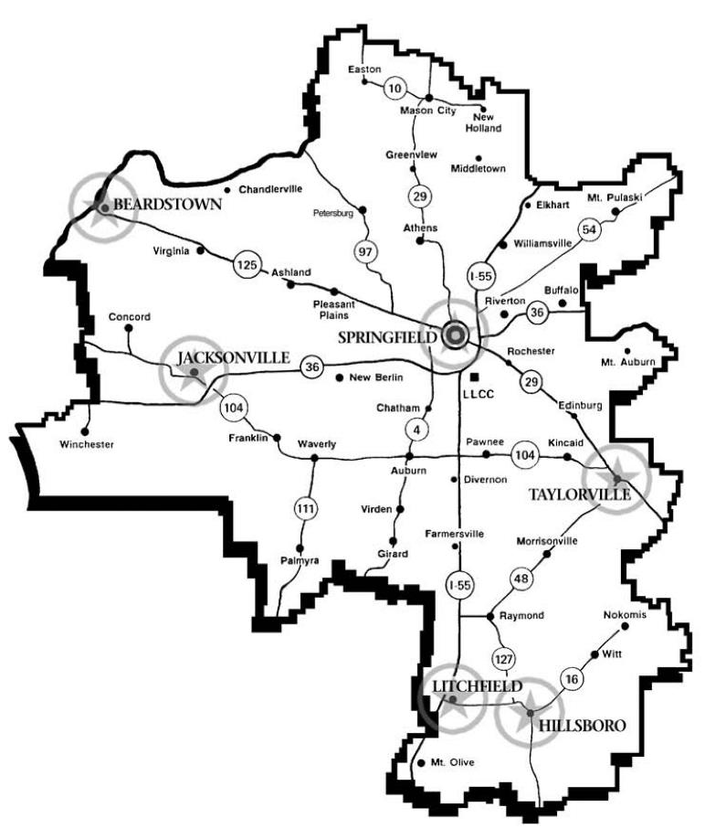
District 526
The LLCC District is composed of all or parts of 15 central Illinois counties: Bond, Cass, Christian, DeWitt, Fayette, Greene, Logan, Macon, Macoupin, Mason, Menard, Montgomery, Morgan, Sangamon and Scott.
Lincoln Land Community College Website:
www.llcc.edu

Slide 14
Getting Started at LLCC
Complete the Application (free) – www.llcc.edu
Attend New Student Orientation (free) – In person or online!
Meet with your Advisor/Success Coach (free) In person, online or walk in hours
Visit www.llcc.edu/getting-started for details!

Slide 15
TRUCK DRIVER TRAINING (CDL)
Transportation Center of Excellence
Certificate Program - successfully equip you for a career in the trucking industry:
Truck Driver Training CDL Basic, Certificate of Completion
Time to completion: 4 weeks (day) or 6 weeks (night)
The program has four 2004 and one 2016 Freightliner tractors with straight 10 speeds and 53′ box trailers.
For more information or to schedule an appointment, please contact
Curt Robinson at 217-786-2565, 217-786-4539 or Curt.Robinson@llcc.edu
www.llcc.edu/truck-driver-training/

Slide 16
Highway Construction Careers Training –
www.llcc.edu/highway-construction-careers-training
IDOT has funded this program to expand the number of people in historically underrepresented populations who enter a highway construction career.
This is an intensive program that addresses skills necessary for acceptance into a highway construction career: math for the trades, job readiness and technical skills coursework.
Students will leave the completed highway construction careers training with the following certifications: OSHA 10, Forklift, CPR/First Aid Training, Flagger and Scissor lift.
Students will have gained the opportunity to excel when applying for a new career with high wage earning potential.
For more information or to register for an orientation, please contact Thomas Spears at
217-786-3675, 217-786-2407 or thomas.spears@llcc.edu

Slide 17
Contact and visit information
Mac Warren
Mac.Warren@llcc.edu
Campus Visit Days and program expos are offered throughout the year.
For information on upcoming visit opportunities, https://www.llcc.edu/visit-llcc

Slide 18

Senior Community Service Employment Program (SCSEP)
You can JOIN US by applying online at: https://www.nationalable.org/about/
or by calling 855-994-8300!
Must be at least 55 years of age
Meet program income requirements
Are willing to improve your job skills and learn new skills
You will:
  Receive interviewing and job-search assistance
  Obtain computer and vocational training
  Earn while you learn at a location in your community
  Gain access to employers who want to hire experienced workers
  Improve your employable skills
Notes:
The Senior Community Service Employment Program (SCSEP) is a community service and work-based job training program for older Americans. Authorized by the Older Americans Act, the program provides training for low-income, unemployed seniors. Participants also have access to employment assistance through your local American Job Centers.

Slide 19

Sangamon County Department of Community Resources
The Sangamon County Department of Community Resources strives to improve the quality of life for people in-need in Sangamon County through department programs, services and referrals that promote economic stability and/or self-motivation.
Available Current Services:
Employment Support Program
Financial Literacy Workshop
Low Income Sewer Assistance Program (LISAP)
Rental Assistance
Scholarship Program
Senior Food Boxes
SCCR Website:
https://sangamonil.gov/departments/a-c/community-resources/programs-and-services
The website includes more detailed information about resource and program availability and requirements, as well as opportunities to apply for programs.
Notes:
If you are a resident of Sangamon County, The Department of Community Resources offers programs, services, and referrals that help promote economic stability. You may have heard of the Low Income Home Energy Assistance Program (LIHEAP), Home Weatherization Services, and several services that they provide through a Community Services Block Grant Program (CSBG).

Slide 20
United Migrant Opportunity Services - National Farmworker Jobs Program (NFJP)
The National Farmworker Jobs Program (NFJP) provides career services, training, youth services, housing, and financial assistance to eligible Migrant and Seasonal Farmworkers (MSFW) and their dependents who reside in Illinois, Missouri, and Wisconsin.
Examples of trainings/certificates include:
Precision Agriculture Technology and Methods
Farm Machine & Diesel Mechanic,
CDL Truck Driving License
and more!
NFJP Eligibility Questionnaire:
https://www.umos.org/nfjp-application/
CONTACT:
UMOS – Champaign/Savoy Office
1803 Woodfield Drive, Suite E
Savoy, IL 61874
Call 217-954-0660

Slide 21
www.illinoisworknet.com
All of the services discussed are offered throughout the state at many locations.
Notes:
Does anyone have any questions for any of today’s presenters? Specific Questions – please feel free to stay after.

Slide 22
Questions?
Illinois WorkNet Center, 1300 S. 9th Street,
Springfield, IL 62703
217-524-5996
https://worknet20.org/contact-us/
Email us at: worknet20@worknet20.org
Land of Lincoln Workforce Alliance is an equal opportunity employer/program. Auxiliary aids and services are available upon request to individuals with disabilities. No individual shall be excluded from participation in, denied the benefit of, subjected to discrimination under, or denied employment in the administration of or in connection with any such program because of race, religion, sex (including pregnancy, gender identity, and sexual orientation) parental status, national origin, age, disability or political affiliation or belief or military service.
Notes:
Does anyone have any questions for any of today’s presenters? Specific Questions – please feel free to stay after.

